Slide 1
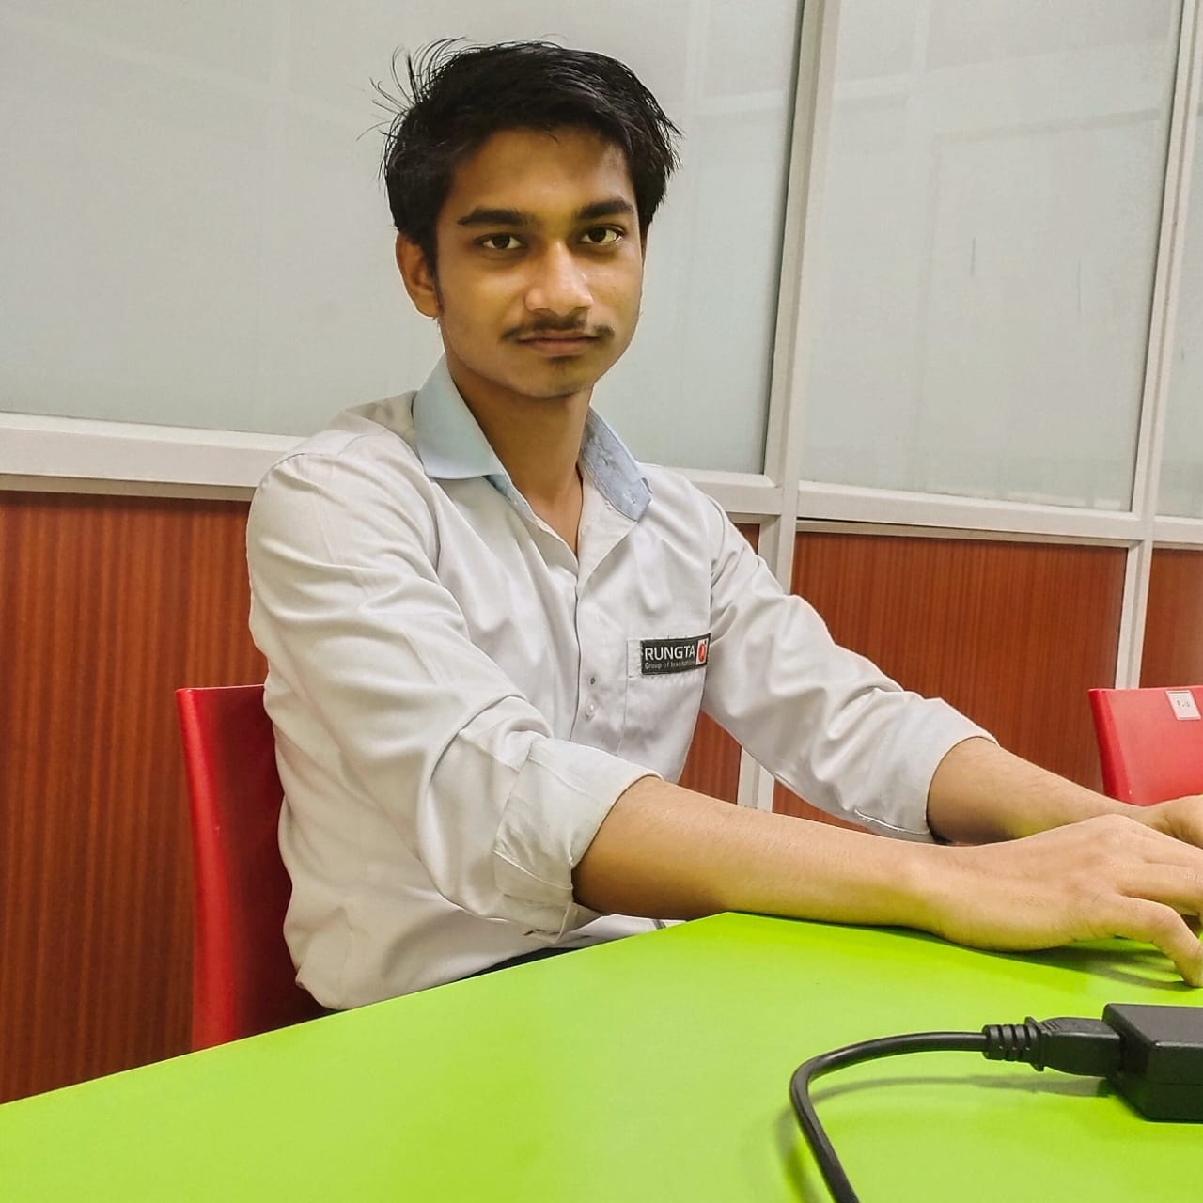
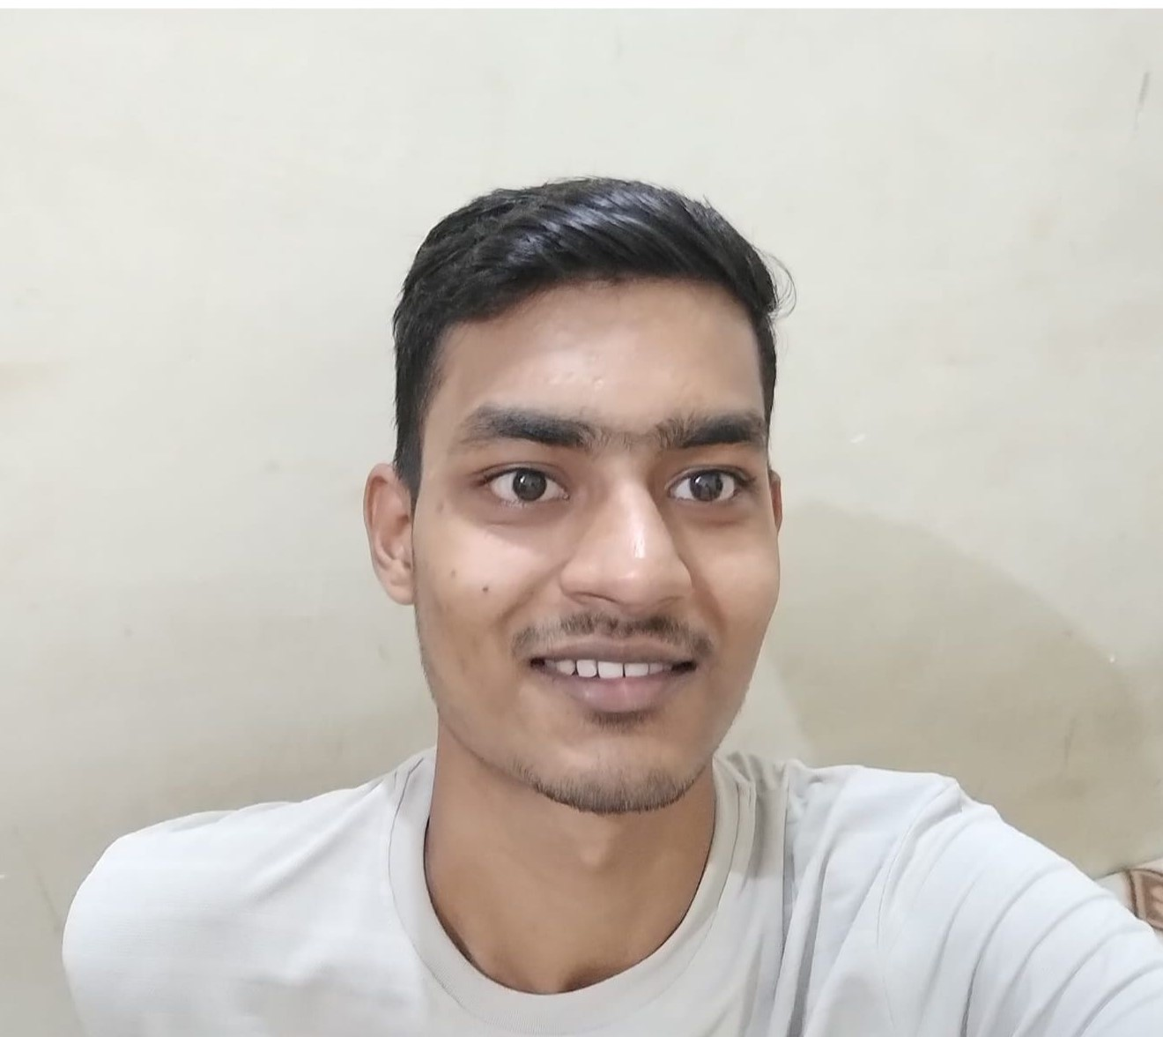
Mir Moyin Rahman (Team Leader) Phone No.-9993894214 E-mail- mirmoyin7@gmail.com Ashish Kumar (Team Member) Phone No.- 9661254195 E-mail- asgupta1910@gmail.com
Gen-A-Thon Team: Techions

Slide 2
Problem statement
Streamlining Student Maintenance Complaints
Building an Intuitive Application for Efficient Resolution and Progress Tracking
Current complaint handling is inefficient and time-consuming.
Difficulty in tracking and resolving student maintenance issues.
Lack of a user-friendly platform for submitting and monitoring complaints.
Solution
Creating an intuitive application to streamline the entire complaint process.
Our app has login access using ID & password separate for both admin and student.
The app will contain tracking feature by entering unique complain number.
If a student has forgotten their ID password, they will need to undergo OTP verification. After successful verification, they will receive their ID password via email or SMS.
Both user and admin can track complain with in the app.

Slide 3
Key-Features
Dependencies
Stable Internet connectivity.
APIS
SDKS
User-friendly(UI-UX)for complaint submission.
Well maintained Dashboard for both(admin & user).
Real-time tracking and status updates.(in App)
Checking staff availability and assigning task.
Efficient communication between the admin and staff.
Highly secured(Admin login).
Instant Tracking(without login) using unique complain ID
Technology Used
Figma, Dart, Java, Php, C#, Nodejs
Android Studio, Vs-code
Firebase and PostgreSQL
Figma(UI-UX)

Slide 4
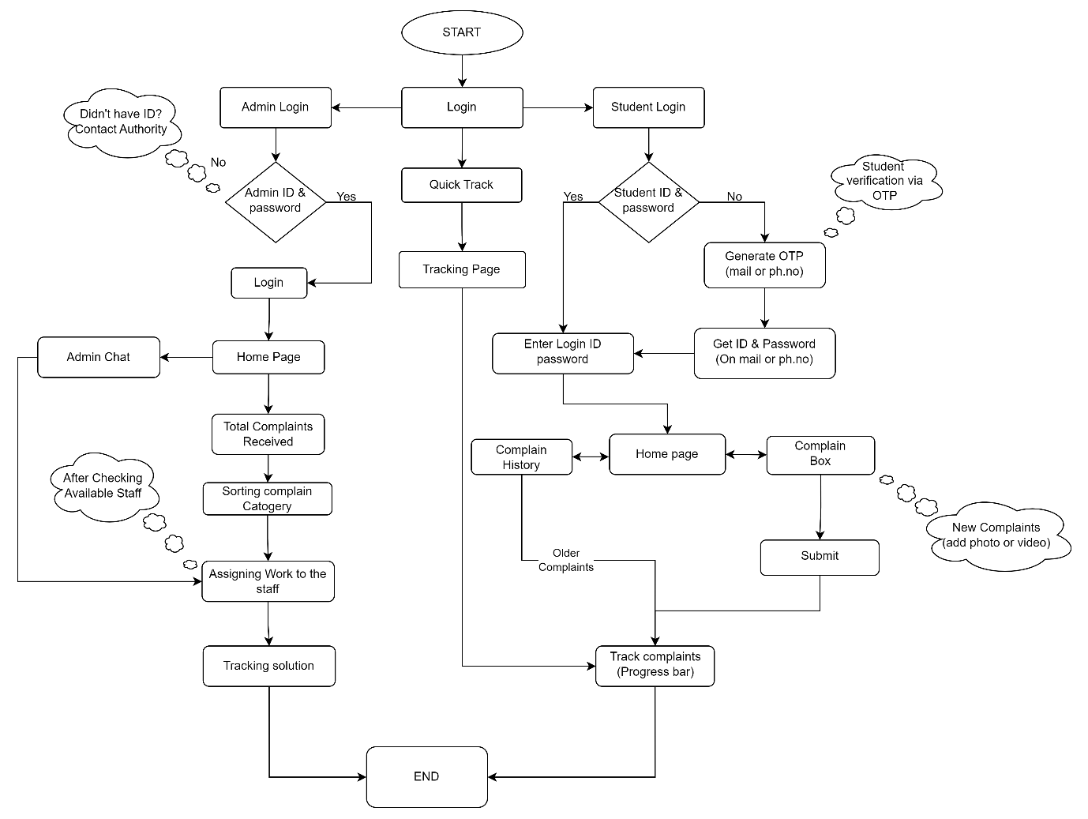
Data Flow Diagram

Slide 5
Future Aspect
In future we can integrate many features in our app some of these are mention below.
For Users
Student Time Table
Assignment Submission
Event’s Update
Attendance Record
Subject and faculties information
Exam Reports
Notice
Chat-Bot(for Students)
For Admin/Employees
Taking Attendance
Online Exams
Providing Assignments
Fess
Sending notifications

Slide 6
Drive Link
https://drive.google.com/drive/folders/1Le8OIdLfZBk1tqinJ3oqaGyuY7VA-4b9

